Slide 1
INST 346 Spring 2025
Lectures 7 and 8
February 17 and 19, 2025
Professor Keith Marzullo

Slide 2
Lab this week
You will start becoming acquainted with the Raspberry Pi
a single-board computer that gives you hands-on experience with a microprocessor
You will be using VNC to interface with the device
Download at https://www.realvnc.com/en/connect/download/viewer/?lai_vid=PXL4qKMrViGGq (or web search “Download VNC Viewer by RealVNC”)

Slide 3
Software Week learning objectives
Why we usually – but not always – program using higher-level languages
The bird’s-eye view and worm’s-eye view of software systems
Virtualization of resources
Context switching and threads, processes, and virtual machines
Virtual memory: memory management units
Virtual memory: demand paging and why the page replacement policy is important

Slide 4
Computing Systems – hardware and software
Applications
Runtime Environment
Operating System
Drivers
Virtual Machine
Machine Language
CPU
ALU
Memory Elements
Boolean Arithmetic
Sequential Logic
Boolean Logic

Slide 5
Machine language, assembler, and higher-level languages
A computer executes machine instructions, which are very tedious to generate by hand
An assembler is a low-level programming language that eases the task of writing machine instructions
A high-level language allows a programmer to write a program independent of the instruction set architecture
Example: computing Fibonacci numbers
fibo(0) = 0, fibo(1) = 1, fibo(n > 2) = fibo(n-1) + fibo(n-2)
0, 1, 1, 2, 3, 5, 8, 13, 21, 34, 55 …

Slide 6
Fibonacci program
Python
ARM Assembly
ARM ISA
def fibo(n):
if (n <= 0):
return(0)
f, f0, f1 = 0, 0, 1
while n > 1:
f = f1 + f0
f0 = f1
f1 = f
n -= 1
return(f)
fibo:
push {r4, lr}
mov r2, #0 ;f=0
cmp r0, #0 ;r0 is n
ble end_fibo
mov r4, #0 ;f0=0
mov r1, #1 ;f1=1
fibo_loop:
add r2, r4, r1 ;f=f1+f2
mov r4, r1 ;f0=f1
mov r1, r2 ;f1=f
sub r0, r0, #1
cmp r0, #1
bgt fibo_loop
end_fibo:
mov r0, r2 ;return f
pop {r4, pc}
E92D4010
E3A02000
E3500001
DA000009
E3A04000
E3A01001
E0842001
E1A04001
E1A01002
E2400001
E3500001
CAFFFFFB
E1A00002
E8BD8010
When would one want to program in assembly?

Slide 7
“There’s plenty of room at the top”
Matrix multiplication
for i in xrange(4096):
for j in xrange(4096):
for k in xrange(4096):
C[i][j] += A[i][k] * B[k][j]
Version | Implementation | Running time (s) | GFLOPS | Absolute speedup | Relative speedup | Fraction of peak (%)
1 | Python | 25,552,48 | 0.005 | 1 |  | 0.01
2 | Java | 2,372.68 | 0.058 | 11 | 10.8 | 0.01
3 | C | 542.67 | 0.253 | 47 | 4.4 | 0.03
4 | Parallel loops | 69.8 | 1.969 | 366 | 7.8 | 0.24
5 | Prl. divide/ conquer | 3.80 | 36.180 | 6,727 | 18.4 | 4.33
6 | … plus vectorization | 1.10 | 124.914 | 23,224 | 3.5 | 14.96
7 | … plus AVX intrinsics | 0.41 | 337.812 | 62,806 | 2.7 | 40.45
Charles E. Leiserson, Neil C. Thompson, Joel S. Emer, Bradley S. Kuszmaul, Butler W. Lampson, Daniel Sanchez, Tao B. Schardel. There’s plenty of room at the Top: What will drive computer performance after Moore’s law? Science vol 368 no 6495 (June 5, 2020). https://www.science.org/doi/10.1126/science.aam9744
Notes:
From article: How can this naïve matrix-multiplication code be performance engineered? Simply choosing a more efficient programming language speeds up this calculation dramatically. For example, coding it in Java (version 2) produces a speedup of 10.8×, and coding it in C (version 3) produces an additional speedup of 4.4×, yielding an execution time that is 47 times faster than the original Python. This performance improvement comes from reducing the number of operations the program performs. In particular, Java and C avoid the extraneous work that Python does under the hood to make programming easier. The price for this performance gain is programmer productivity: Coding in C is more onerous than coding in Python, and Java lies somewhere in between.
Although switching languages gains a speedup of almost 50×, tailoring the matrix code to exploit specific features of the hardware makes it run an additional 1300 times faster. This gain comes from parallelizing the code to run on all 18 of the processing cores (version 4), exploiting the processor’s memory hierarchy (version 5), vectorizing the code (version 6), and using Intel’s special Advanced Vector Extensions (AVX) instructions (version 7). The final optimized code performs the task in only 0.41 s—more than 60,000 times faster than the 7 hours of the original Python code!

Slide 8
Software systems: Two points of view (1)
Bird’s eye view: A system provides a set of abstractions, extending (or sometimes totally obscuring) the layers underneath.
file system
concurrency, virtual memory
Operating System
Independent ISA
Virtual Machine
device-independent input/output
Drivers
Virtualization: a resource that, to the user, appears to be real
virtual machine, virtual memory, virtual devices, virtual networks…

Slide 9
Software systems: Two points of view (2)
Worm’s eye view: A system manages a set of resources
Processors
Primary memory
Secondary memory
Concurrency: threads, processes, virtual machines
Primary memory: virtual memory
File systems: stable storage

Slide 10
Multiprocessing: Sharing a processor
…
…
count = input(“Enter number”)
…
…
The program waits for the user to enter a number.
The processor that was executing this program can be used to execute another program.
Call the representation of the state of execution a context
Context switch: Save the context of the first program and load the context of another program that is ready to execute

Slide 11
Multiprocessing
What is a “context”?
Threads: share an address space. Each has own stack and registers and program counter
Processes: share an operating system. Each has own address space as well as stack, registers, and program counter
Virtual machines: share nothing. Each has own virtualized computer.
For each, when would it be useful to use?

Slide 12
Threads
Multiple loci of control in a program
Small context: Light weight and powerful
Communication using shared memory
Riace conditions:
{balance = 200} {balance = 200}
1: r1 = balance 4: r2 = balance
2: r1 = r1 + 1000 5: r2 = r2 - 100
3: balance = r1 6: balance = r2
{balance = 100}
The goal was for balance to be 1100, but instead is 100
Requires concurrency control (locks, semaphores, monitors, synchronized methods)

Slide 13
Processes
A locus of control with its own address space but concurrent with other processes
Useful for sharing a CPU in a safe manner
A natural model for distributed computing
Communication using message passing/pipes
Context includes all of address space: heavier weight than threads

Slide 14
Virtual machines
A locus of control consisting of a dedicated CPU
A way of multiplexing CPUs with strong isolation
Context includes entire state of a virtual CPU
Communication through networking, shared file systems, etc.
Used for emulation, cloud computing, and for security purposes

Slide 15
Virtual memory
contiguous region of virtual memory
Virtual memory: the full amount of addressable memory
Physical memory: the main memory the computer possesses
The memory is tiled into pages (of virtual memory) and page frames (of physical memory)
Virtual memory exists on backing store
Hardware memory manager facilitates:
the translation of virtual addresses to physical addresses
transferring of pages between backing store and physical memory
page frames in physical (main) memory on computer
pages in virtual memory
on backing store

Slide 16
Why is virtual memory useful?
Virtual memory:
Shares a limited resource through time multiplexing
Implements a memory firewall that isolates processes (and virtual machines) from each other
Also provides a way to implement memory mapped file access
A segment of a file is associated with a range of virtual memory addresses
Assuming an address refers to a byte:
32-bit address: 4GB
64-bit address: 16EB
Main memory for my devices:
Apple watch: 1GB
iPhone: 8GB
personal Mac laptop: 24GB
University PC laptop: 16G
University Mac laptop: 32GB
Virtual memory originated with the University of Manchester’s Atlas Computer project of the late 1950a.

Slide 17
Old-school virtual memory example
20 bits
12 bits
page
offset
Assume:
Byte-addressable memory
32-bit addresses
Virtual memory address can span up to 4GB (0 – 0xFFFFFFFF)
128MB of physical memory (0 – 0x7FFFFFF)
Page size of 4KB
Virtual memory has up to 1M pages
Physical memory has 32K page frames
Translating from page to page frame is done by hardware (memory management unit) that references a page table
32 bits
Two videos on virtual memory and page fault processing:
https://www.youtube.com/watch?v=LKYKp_ZzlvM
https://www.youtube.com/watch?v=lY44D2u21Vg

Slide 18
Translating virtual addresses to physical addresses: Page table
The page table has a 4-byte entry per page
Each entry contains the page frame number the page occupies and some flags
The page table resides in physical memory (why?)
resident/vacant
referenced
dirty
permissions (rwx)
process ID
…
20 bits
12 bits
page frame
flags
32 bits
page table entry
1M page table entries = 4MB long page table

Slide 19
Translating virtual addresses to physical addresses: Page table (1)
write to virtual address 1274A05C
…
resident
referenced
dirty
12748
614
T
T
T
12749
F10
T
T
F
1274A
13D
T
F
F
1274B
F11
F
F
F
1274C
B12
T
T
T
1274D
13B
T
F
T
…
page table

Slide 20
Translating virtual addresses to physical addresses: Page table (2)
write to virtual address 1274A05C
1274A
05C
…
resident
referenced
dirty
12748
614
T
T
T
12749
F10
T
T
F
1274A
13D
T
F
F
1274B
F11
F
F
F
1274C
B12
T
T
T
1274D
13B
T
F
T
…
page table

Slide 21
Translating virtual addresses to physical addresses: Page table (3)
write to virtual address 1274A05C
1274A
05C
…
resident
referenced
dirty
12748
614
T
T
T
12749
F10
T
T
F
1274A
13D
T
F
F
1274B
F11
F
F
F
1274C
B12
T
T
T
1274D
13B
T
F
T
…
page table

Slide 22
Translating virtual addresses to physical addresses: Page table (4)
permissions don’t match? permissions fault
incorrect process ID? segment fault
write to virtual address 1274A05C
1274A
05C
…
resident
referenced
dirty
12748
614
T
T
T
12749
F10
T
T
F
1274A
13D
T
T
T
1274B
F11
F
F
F
1274C
B12
T
T
T
13D
05C
1274D
13B
T
F
T
…
page table

Slide 23
Translating virtual addresses to physical addresses: Page table (5)
write to virtual address 1274A05C
1274A
05C
…
resident
referenced
dirty
12748
614
T
T
T
12749
F10
T
T
F
1274A
13D
T
T
T
1274B
F11
F
F
F
1274C
B12
T
T
T
13D
05C
1274D
13B
T
F
T
…
CPU writes to physical address 13D05C
page table

Slide 24
Translating virtual addresses to physical addresses: Page table (6)
read from virtual address 1274B000
…
resident
referenced
dirty
12748
614
T
T
T
12749
F10
T
T
F
1274A
13D
T
T
T
1274B
F11
F
F
F
1274C
B12
T
T
T
1274D
13B
T
F
T
…
page table

Slide 25
Translating virtual addresses to physical addresses: Page table (7)
read from virtual address 1274B000
1274B
000
…
resident
referenced
dirty
12748
614
T
T
T
12749
F10
T
T
F
1274A
13D
T
T
T
1274B
F11
F
F
F
1274C
B12
T
T
T
1274D
13B
T
F
T
…
page table

Slide 26
Translating virtual addresses to physical addresses: Page table (8)
read from virtual address 1274A05C
1274B
000
…
resident
referenced
dirty
12748
614
T
T
T
12749
F10
T
T
F
1274A
13D
T
F
F
1274B
F11
F
F
F
page fault
1274C
B12
T
T
T
1274D
13B
T
F
T
…
page table

Slide 27
Virtual memory: Managing page frames
If a reference raises a page fault, the operating system:
pauses execution of the program that faulted
locates a free page frame
reads the faulted page from backing store into that page frame
updates the page table
resumes execution of the paused program
Page fault penalty: how much time it takes to do all this?
memory access takes a few nanoseconds
100,000 nanoseconds to read page from SSD

Slide 28
Finding a vacant page frame: Frame table
Frame table: indexed by page frame
Also called inverted page table
recall page table indexed by page. This is indexed by page frame.
Our example: 4 byte entry
1 bit: vacant
20 bits: page (if not vacant)
Requires 128KB
Page fault software scans this array to identify a vacant page frame
What if no page frames are vacant?

Slide 29
Page replacement policy
Identify a page to evict from page frame
If page is dirty, need to copy to backing store first
Different replacement policies:
Optimal: replace page that will be referenced farthest in the future
FIFO: implement with stack, updated on each page in
LRU: (“past predicts the future”): implement with stack, updated on each reference
Typically, LRU is much closer to optimal than FIFO
HotStorage ‘20 paper arguing that it’s time to reconsider FIFO for large caches: https://www.usenix.org/conference/hotstorage20/presentation/eytan
SOSP paper arguing that FIFO queues are all you need for cache eviction:
https://dl.acm.org/doi/10.1145/3600006.3613147

Slide 30
LRU and LRU approximation (Clock)
Implementing LRU requires maintaining a list of page frames in last-referenced order, which is a complex data structure updated with every page reference
An approximation: Clock
Periodically scan page frames:
Writes dirty pages to backing store
Marks page as unreferenced
Replace pages that have not been recently referenced

Slide 31
LRU approximation (Clock) 1
¬ref, ¬dirty
Clock: Operating system moves “hand” across frame table at some rate
¬ref, ¬dirty
¬ref, ¬dirty
ref, ¬dirty
¬ref, ¬dirty
ref, ¬dirty
ref, ¬dirty
¬ref, ¬dirty
ref, dirty
ref, ¬dirty
ref, ¬dirty
ref, ¬dirty
ref, ¬dirty
¬ref, ¬dirty
ref, ¬dirty
ref, ¬dirty

Slide 32
LRU approximation (Clock) 2
¬ref, ¬dirty
Clock: Operating system moves “hand” across frame table at some rate:
If page frame is not dirty, mark as unreferenced
¬ref, ¬dirty
¬ref, ¬dirty
ref, ¬dirty
¬ref, ¬dirty
ref, ¬dirty
ref, ¬dirty
¬ref, ¬dirty
ref, dirty
ref, ¬dirty
ref, ¬dirty
ref, ¬dirty
ref, ¬dirty
¬ref, ¬dirty
ref, ¬dirty
ref, ¬dirty

Slide 33
LRU approximation (Clock) 3
¬ref, ¬dirty
Clock: Operating system moves “hand” across frame table at some rate:
If page frame is not dirty, mark as unreferenced
¬ref, ¬dirty
¬ref, ¬dirty
ref, ¬dirty
¬ref, ¬dirty
ref, ¬dirty
¬ref,¬dirty
¬ref, ¬dirty
ref, dirty
ref, ¬dirty
ref, ¬dirty
ref, ¬dirty
ref, ¬dirty
¬ref, ¬dirty
ref, ¬dirty
ref, ¬dirty

Slide 34
LRU approximation (Clock) 4
¬ref, ¬dirty
Clock: Operating system moves “hand” across frame table at some rate:
If page frame is not dirty, mark as unreferenced
If page frame is dirty, schedule writing back to backing store
¬ref, ¬dirty
¬ref, ¬dirty
ref, ¬dirty
¬ref, ¬dirty
ref, ¬dirty
¬ref, ¬dirty
¬ref, ¬dirty
ref, dirty
ref, ¬dirty
ref, ¬dirty
ref, ¬dirty
ref, ¬dirty
¬ref, ¬dirty
ref, ¬dirty
ref, ¬dirty

Slide 35
LRU approximation (Clock) 5
¬ref, ¬dirty
Clock: Operating system moves “hand” across frame table at some rate:
If page frame is not dirty, mark as unreferenced
If page frame is dirty, schedule writing back to backing store
¬ref, ¬dirty
¬ref, ¬dirty
ref, ¬dirty
¬ref, ¬dirty
ref, ¬dirty
¬ref, ¬dirty
¬ref, ¬dirty
ref, dirty
ref, ¬dirty
ref, ¬dirty
ref, ¬dirty
ref, ¬dirty
¬ref, ¬dirty
ref, ¬dirty
ref, ¬dirty

Slide 36
LRU approximation (Clock) 7
page in this frame is read
¬ref, ¬dirty
Clock: Operating system moves “hand” across frame table at some rate:
If page frame is not dirty, mark as unreferenced
If page frame is dirty, schedule writing back to backing store
¬ref, ¬dirty
¬ref, ¬dirty
ref, ¬dirty
¬ref, ¬dirty
ref, ¬dirty
ref, ¬dirty
¬ref, ¬dirty
ref, dirty
ref, ¬dirty
ref, ¬dirty
ref, ¬dirty
ref, ¬dirty
¬ref, ¬dirty
ref, ¬dirty
ref, ¬dirty

Slide 37
LRU approximation (Clock) 9
¬ref, ¬dirty
Clock: Operating system moves “hand” across frame table at some rate:
If page frame is not dirty, mark as unreferenced
If page frame is dirty, schedule writing back to backing store
¬ref, ¬dirty
¬ref, ¬dirty
ref, ¬dirty
¬ref, ¬dirty
ref, ¬dirty
ref, ¬dirty
¬ref, ¬dirty
ref, dirty
ref, ¬dirty
ref, ¬dirty
page in this frame is written
ref, dirty
ref, ¬dirty
¬ref, ¬dirty
ref, ¬dirty
ref, ¬dirty

Slide 38
LRU approximation (Clock) 10
¬ref, ¬dirty
Clock: Operating system moves “hand” across frame table at some rate:
If page frame is not dirty, mark as unreferenced
If page frame is dirty, schedule writing back to backing store
¬ref, ¬dirty
¬ref, ¬dirty
ref, ¬dirty
¬ref, ¬dirty
ref, ¬dirty
ref, ¬dirty
¬ref, ¬dirty
ref, dirty
ref, ¬dirty
ref, ¬dirty
ref, dirty
ref, ¬dirty
¬ref, ¬dirty
ref, ¬dirty
ref, ¬dirty

Slide 39
LRU approximation (Clock) 11
¬ref, ¬dirty
Clock: Operating system moves “hand” across frame table at some rate:
If page frame is not dirty, mark as unreferenced
If page frame is dirty, schedule writing back to backing store
¬ref, ¬dirty
¬ref, ¬dirty
ref, ¬dirty
¬ref, ¬dirty
ref, ¬dirty
ref, ¬dirty
¬ref, ¬dirty
ref, dirty
ref, ¬dirty
¬ref,¬dirty
ref, dirty
ref, ¬dirty
¬ref, ¬dirty
ref, ¬dirty
ref, ¬dirty

Slide 40
LRU approximation (Clock) 12
page write to backing store completed
¬ref, ¬dirty
Clock: Operating system moves “hand” across frame table at some rate:
If page frame is not dirty, mark as unreferenced
If page frame is dirty, schedule writing back to backing store
¬ref, ¬dirty
¬ref, ¬dirty
ref, ¬dirty
¬ref, ¬dirty
ref, ¬dirty
ref, ¬dirty
¬ref, ¬dirty
¬ref,¬dirty
ref, ¬dirty
¬ref, ¬dirty
ref, dirty
ref, ¬dirty
¬ref, ¬dirty
ref, ¬dirty
ref, ¬dirty

Slide 41
LRU approximation (Clock) 13
¬ref, ¬dirty
Clock: Operating system moves “hand” across frame table at some rate:
If page frame is dirty, schedule writing back to backing store
If page frame is not dirty, mark as unreferenced
If need a frame, find the first frame ahead of the hand that is not referenced
¬ref, ¬dirty
¬ref, ¬dirty
ref, ¬dirty
¬ref, ¬dirty
ref, ¬dirty
ref, ¬dirty
¬ref, ¬dirty
¬ref, ¬dirty
ref, ¬dirty
ref, ¬dirty
ref, ¬dirty
ref, ¬dirty
¬ref, ¬dirty
ref, ¬dirty
release this frame
ref, ¬dirty

Slide 42
Virtual memory: wrap up
There are lots of details we’ve omitted!
Hardware support to make this even faster
Memory caches
Translation lookaside buffers (TLB)
As addresses get longer (eg, 64 bit) page tables can get huge
Multi-level page tables
Prefetching pages: paging something in before it is referenced
Avoiding paging out by memory compression
ACM Transactions on Computer Systems Volume 14, Number 4: Implementation and performance of integrated application-controlled file caching, prefetching, and disk scheduling
https://dl.acm.org/doi/10.1145/235543.235544

Slide 43
Software week key points
Why we usually – but not always – program using higher-level languages
The bird’s-eye view and worm’s-eye view of software systems
Virtualization of resources
Context switching and threads, processes, and virtual machines
Virtual memory: memory management units
Virtual memory: demand paging and why the page replacement policy is important

Slide 44

Guest lecture: Values in Internet architecture
Dr. Katie Shilton is a professor in the College of Information. She leads the Ethics & Values in Design (EViD) Lab. Her research focuses on technology and data ethics. She is a co-PI of the NSF and NIST-funded TRAILS Institute focused on trustworthy AI, and a co-PI of UMD’s Values Centered AI Initiative. She was also recently the PI of the PERVADE project, a multi-campus collaboration focused on big data research ethics. Other projects include improving online content moderation with human-in-the-loop machine learning techniques and designing experiential data ethics education.

Slide 45
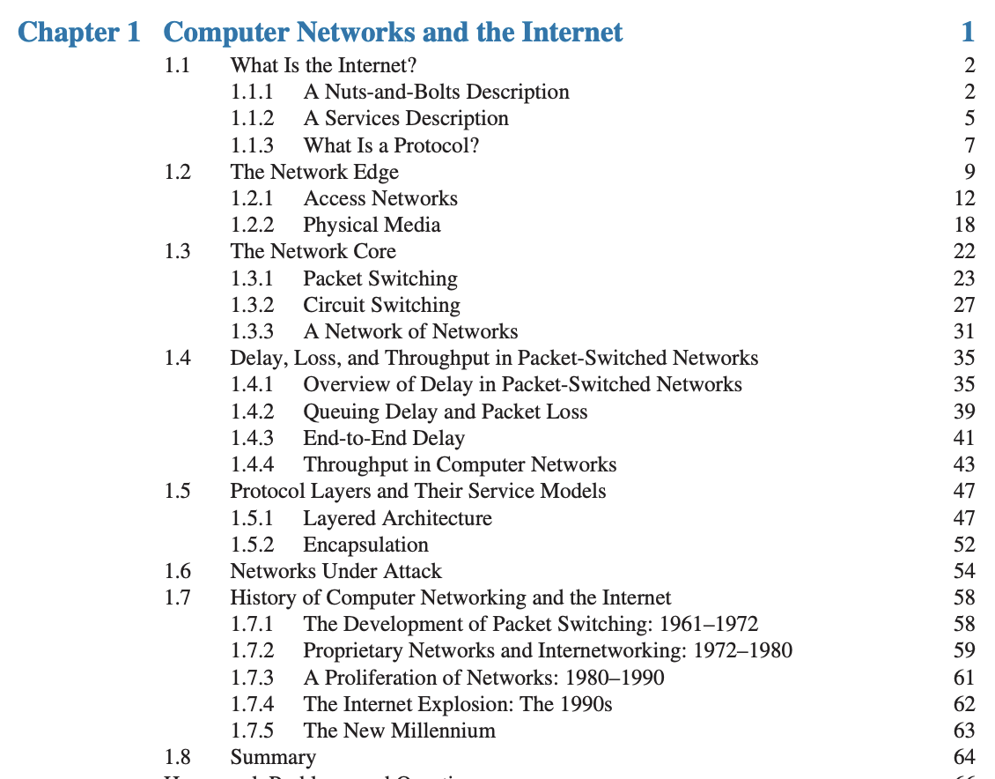
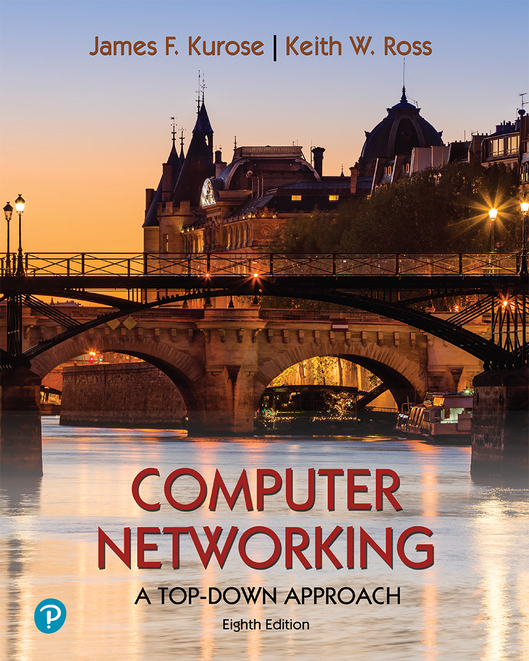
Next week: Overview of the Internet
Please read Sections 1.1-1.3
Computer Networking: A Top-Down Approach . 8th edition Jim Kurose, Keith Ross Pearson, 2020

